Slide 1

988
Officially went live in Washington on July 16, 2022

Slide 2
About 988
988 offers 24/7/365 call, text, and chat access to trained counselors, no matter where someone lives in the United States, when experiencing:
  thoughts of suicide,
  a mental health or substance use crisis, or
  any other kind of emotional distress.
  Access is available through every land line, cell phone, and voice-over internet device in the United States.
988 operates through what is known as the National Suicide Prevention Lifeline network, which consists of over 200 locally owned and funded crisis centers across the country.

Slide 3
About 988
Veterans and service members may reach the Veterans Crisis Line by pressing 1 after dialing 988 or by texting 838255.
988 currently serves TTY users either through their preferred relay service or by dialing 711 then 1-800-273-8255.
988 telephone services are available in Spanish by pressing 2.
Interpretation services are available in over 250 languages.
  Text and chat are currently available in English only
  Chat is available through the Lifeline’s website at 988lifeline.org/chat.
Washington launched Native and Strong Lifeline, dedicated to serving American Indian and Alaska Native individuals who call 988 and press 4.

Slide 4
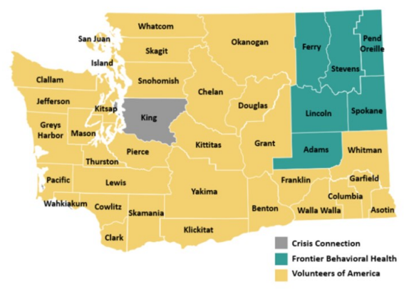
WAShington State 988 Coverage
Notes:
In Washington State, there are three crisis centers operated by:
Frontier Behavioral Health (6-county area)
Volunteers of America of Western Washington (32-county area)
Crisis Connections (1-county area)
Frontier Behavioral Health has made progress in recruiting and hiring vacant positions to support the implementation of 988 statewide. We only have a few positions left to fill.
Prior to July 16th, we implemented a new secure cloud-based platform that utilizes the internet instead of traditional phone lines to send and receive signals which will support teleworking. Teleworking has the benefit of providing flexible work environment for staff which will also help limit the potential impact of potential power outages because staff live in different areas that are not impacted by the outage enabling staff to continue answering calls.
We have worked on enhancing our staff training and professional development and included trainings that help staff build skills and knowledge in working with certain populations in our region such as farm workers. We are actively recruiting for a Diversity, Equity and Inclusion Coordinator who will train and coach RCL/NSPL/988 staff to provide culturally affirming crisis response services for all communities based on many factors including geographical location, gender identity, sexual identity, race, ethnicity, and national origin among other identities.

Slide 5
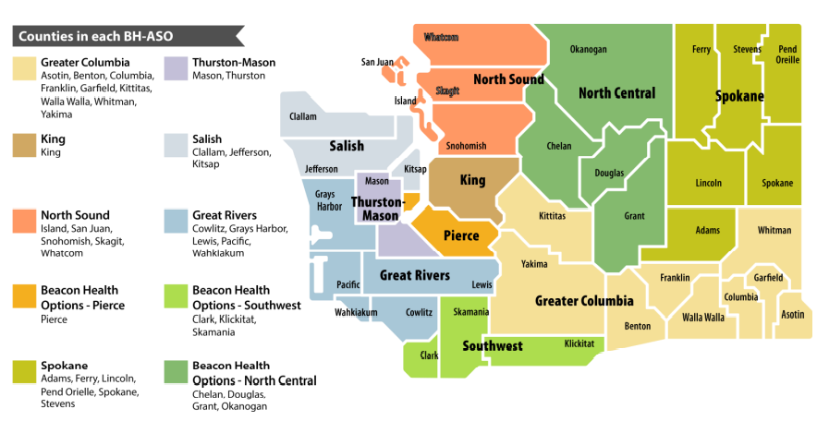
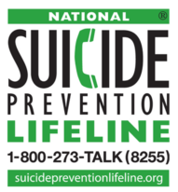
Existing Crisis
Lines Remain aCtive
The BH-ASOs’ Regional
Crisis Lines
The National Suicide
Prevention Lifeline
10-Digit Number
1-877-266-1818

Slide 6
PRE/POST 988
Implementation Data
July 2021 – June 2022
August – November 2022
RCL MONTHLY AVERAGE:
Number of calls answered: 3,743
Length of call: 6 minutes, 23 seconds
LIFELINE MONTHLY AVERAGE:
Number of calls answered: 257 calls
Length of call: 12 minutes, 14 seconds
RCL MONTHLY AVERAGE:
Number of calls answered: 3,625
Length of call: 6 minutes, 56 seconds
LIFELINE MONTHLY AVERAGE:
Number of calls answered: 350 calls
Length of call: 12 minutes, 20 seconds

Slide 7
AUGUST – November 2022
RCL Monthly CALL
988 Monthly Call Data
Month | Calls Answered | Average Talk Time
August | 3515 | 7:12
September | 3737 | 6:48
October | 3814 | 6:45
November | 3432 | 7:00
Month | Calls Answered | Average Talk Time
August | 379 | 13:25
September | 376 | 12:19
October | 359 | 11:15
November | 285 | 12:22

Slide 8
PRE/POST 988
Implementation Data
July 2021 – June 2022
August – November 2022
Total Monthly Average for Both RCL and Lifeline:
Number of calls answered: 4,000
Total Monthly Average for Both RCL and 988/Lifeline:
Number of calls answered: 3,974

Slide 9
988/Lifeline callS by County
Aug-Oct 2022
During the three-month period:
    The majority of calls were associated with Spokane County numbers
    We received between 6-23 calls depending upon the month associated with Lincoln County numbers
    We received between 12-15 calls depending upon the month associated with Stevens County numbers
    We received 6 or less calls each month from numbers associated with each of the three counties- Adams, Ferry, and Pend Oreille

Slide 10
988/Lifeline CALLERs BY Age Range
*Based on callers who provided identifying information*
July 2021 – June 2022
August – November 2021
  1. Ages 20-29 years
  2. Ages 30-39 years
  3. Ages 13-17 years
  1. Ages 20-29 years
  2. Ages 30-39 years
  3. Ages 50-59 years

Slide 11

Questions

Slide 12
988 Resources
https://www.samhsa.gov/find-help/988
https://www.samhsa.gov/find-help/988/faqs
https://doh.wa.gov/sites/default/files/2022-06/971-053-988-OnePagerFastfacts.pdf?uid=630f8c679bcf6
https://doh.wa.gov/sites/default/files/2022-07/971-053-988SuicideAndCrisisLifelineWhatYouNeedToKnow.pdf?uid=630f8c679c0d4
https://doh.wa.gov/sites/default/files/2022-06/971-052-988-SuicideCrisisLifelineFirstResponders.pdf?uid=630f8c679c517
https://doh.wa.gov/newsroom/nations-first-native-and-strong-lifeline-launches-part-988

