Slide 1
Commercial Wind Energy Farms Development Regulations Discussion Planning Commission Public Hearing August 29, 2024
Spokane County Building & Planning
Spokane County Building and Planning

Slide 2
Planning Process
Potential Comprehensive Plan Goals and Policies
Protect agricultural businesses and cropland
Protect civilian and military aviation facilities
Support the production of renewable energy for local and regional uses
Provide economic benefits for farmers, ranchers, and county government
Ensure safety and protection for wildlife, resident birds, and migrating birds

Slide 3
Planning Process
Protect agricultural lands from conflicts and incompatible uses while protecting agribusiness and cropland.
Policy: Discourage the permanent conversion of farmland out of production to renewable energy development.
Policy: Do not locate non-agricultural related industries on “GMA Agriculture” designated land as defined in WAC 365-190-050.

Slide 4
Planning Process
Protect the long-term viability of Fairchild AFB by requiring wind turbines to be sited away from FAFB flight routes and patterns.
Policy: Recognize that commercial wind turbines are an incompatible use near Fairchild AFB
Protect airports in Spokane from encroachment by incompatible uses
Policy: Commercial wind turbines should be encouraged to be developed away from airports and airport influence areas
Policy: Protect airports and flightpaths, commercial windfarms by producing development standards that require commercial windfarms to follow FAA standards.

Slide 5
Planning Process
Support the production of renewable energy for local and regional uses.
Policy: Support the development and growth of renewable energy facilities (i.e., wind power, hydroelectric, solar power, geothermal) that foster economic prosperity (living wage jobs, revenue sources for rural landowners, increased tax base) and increasing the economic diversity of Spokane County.
The County should ensure that the development regulations related to facilities and utilities where appropriate, that are key to developing sustainable renewable energy generation in Spokane County

Slide 6
Planning Process
Provide economic benefits for farmers, ranchers, and county government.
Policy: Create development regulations that protect the county's wildlife species, including priority habitat species, raptors, avian species, and bats, from commercial wind farm development.
Policy: Create development regulations that help protect the county’s open space, wildlife corridors, wildlife refuges, and priority habitat.
Policy: Enforce a no-net-loss of priority habitat from renewable energy development.

Slide 7
Planning Process
Ensure Safety and protection of wildlife, resident, and migrating birds.
Policy: Create development regulations that protect the county's wildlife species, including priority habitat species, raptors, avian species, and bats, from commercial wind farm development.
Policy: Create development regulations that help protect the county’s open space, wildlife corridors, wildlife refuges, and priority habitat.
Policy: Protect priority habitat species from incompatible development. Enforce a no-net-loss of priority habitat from renewable energy development.

Slide 8
Permitting Process
Washington is a dual permitting state – RCW 80.50
Applicant can choose to go through the the local permitting authority or the state Energy Facility Site Evaluation Council. (EFSEC)
If the applicant chooses to obtain a permit through EFSEC, Spokane County will have a representative on the Board.
A recommendation would go to the governor, who would approve, modify, or deny EFSEC’s recommendation.
Spokane County Code has insufficient development regulations to consider industrial-scale renewable energy facility development.

Slide 9
Source: Washington State Department of Ecology, State of Washington Energy Facility Site Evaluation Council. Focus on: Pathway options for environmental review and permitting clean energy projects

Slide 10
Public Safety, Inquires and Complaints
Best Practices
Require posting of emergency contact information
Prevent unauthorized climbing
Post warning signs
Lock turbine doors
Physical monitoring of the site
Fire protection plan
All wind developers provide safety plans including emergency response and design measures to ensure safety and inform potential responders.

Slide 11
Commercial Wind Farm metrics and best practices
Public safety
Wind turbine technical changes over time – height and rotor
Setbacks
Between towers
Adjacent to occupied structures
Municipal or settlement boundaries
Property lines
Environmental and economic protection
Visual resources, noise, and shadow effects
Aviation safety
Decommissioning

Slide 12
Wind Turbine Height
A wind turbine’s hub height is the distance from the ground to the middle of the turbine’s rotor
Turbine height has increased to 322 feet, a 73% increase between 1998-2023
Higher turbines allow longer rotor blades, which capture more wind energy

Slide 13
Wind Turbine Height Graphics
Source: Office of Energy Efficiency & Renewable Energy (Wind Turbines: the Bigger, the Better | Department of Energy)

Slide 14
Height vs (MW) Capacity

Slide 15
Average Rotor Diameter
A turbine’s rotor diameter is the width of the circle swept by the rotating blades.
In 2010 the largest turbine rotor was 380 ft.
In 2022 the average turbine rotor was 430 ft.

Slide 16
Findings for Turbine Height
Best Practices does not recommend height standards or limits.
Tower heights will likely continue to increase for commercial wind farms.
Wind developers need higher turbine heights to increase their energy capacity.
Commercial wind turbines shall follow all FAA standards and guidelines.
The lowest point on all rotor blades must be at least 30 feet above ground level.

Slide 17
Setback Requirements
Proposed code provides four basic setback requirements.
Minimum, non-waivable, occupied building setbacks.
Occupied building visual, shadow flicker, and aesthetic setbacks
Boundaries of incorporated communities
Setbacks from nonparticipating adjacent landowners' property lines.
It is important that setback standards protect the local community, and allow for reasonable development

Slide 18
Minimum occupied building setbacks
Best Practices
The 1,000-foot setback became a standard in part because it created a substantial margin of safety.
1-1.5x safety setback protects against blade throw.
1.1-1.5x blade height is common industry practice.
Code Examples
Adams County 1.1x
Whitman County 1x
Larger setbacks are possible. EFSEC has created some 2,500-foot setbacks for projects.

Slide 19
Occupied building, visual, & aesthetic setbacks
Code Examples
Adams County created a 4x setback
EFSEC Desert CLAIM Project: Created a 2,500-foot setback standard.
Court Cases
Residents Opposed To Kittitas Turbines v State Energy Facility Site Evaluation Council The Washington Supreme court agreed on a general 4x setback standard.

Slide 20
Boundaries of incorporated communities
Scientific Journal Article
Best Practices, “1,000–1,200 m from the closest settlement are the most favorable for reaching optimal energy and environmental objectives” That’s about 7x turbine height
Court Cases
Residents Opposed To Kittitas Turbines v State Energy Facility Site Evaluation Council EFSEC (2008) general 4x turbine height
Notes:
We do not want development regulations to be so restrictive that the developer bypasses the county’s permitting process and goes to EFSEC or Ecology's new coordinated clean energy permitting system.

Slide 21
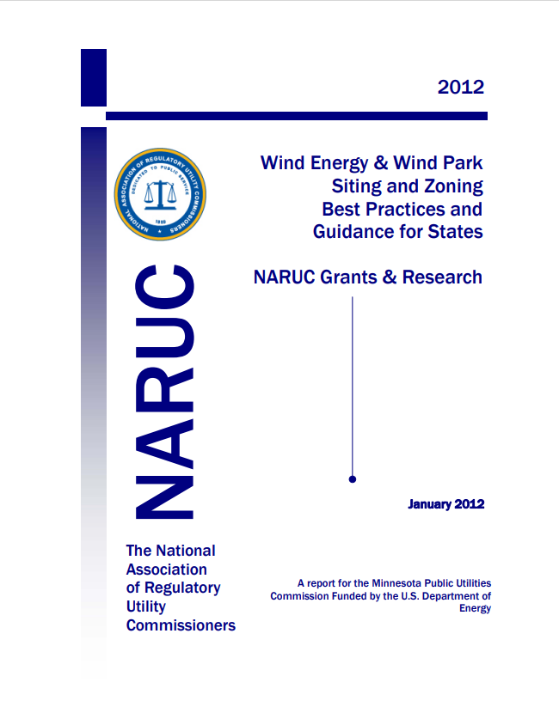
Setbacks from property lines
Best Practices:
1.1 to 1.25x the turbine’s total height is the common standard
1.5x Adams County
Guidelines or mandatory requirements from a handful of states do converge on 1 to 1.5x the turbine height (that is, tower plus blade length, or more accurately, tower plus rotor and blade radius.)
Residents Opposed To Kittitas Turbines v State Energy Facility Site Evaluation Council EFSEC (2008).
Created a 4x standard precedent for setbacks

Slide 22
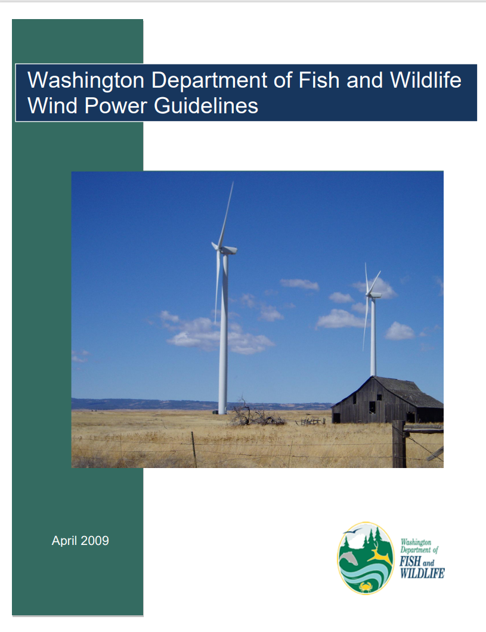
Protecting the Natural Environment
WDFW Wind Power Guidelines
Provides guidance, studies, and mitigation standards for the effects that commercial wind farms have on the natural environment
Protection of priority habitat species and environmental corridors
Protection of prime habitat i.e., scrub steppe
Protection of seasonal flyways
Protection of Turnbull National Wildlife Refuge

Slide 23
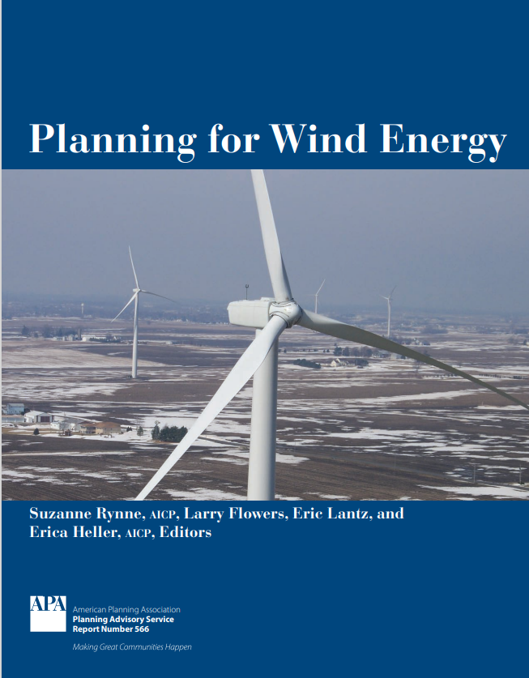
Visual Resources
APA Guidebook Common Practices
Neutral color and nonreflective finish.
Lighted per FAA guidelines with no additional lighting allowed.
Signage limited to the turbine manufacturer, facility owner or operator, and emergency contact information.

Slide 24
Noise/Sound
Ordinances typically require audible noise to be below specific sound thresholds at property lines, often 40 dBA to 55 dBA. More detailed noise standards may cast thresholds in terms of ambient noise levels. (American Planning Association)
For average noise exposure, the GDG conditionally recommends reducing noise levels produced by wind turbines below 45 dBA. (World Health Organization)
Can also be mitigated through setbacks. APA recommends 1000-foot setbacks to mitigate noise.
Washington State noise standard compliance: During construction and operations, the project shall comply with applicable state noise standards as found in WAC 173-60.

Slide 25
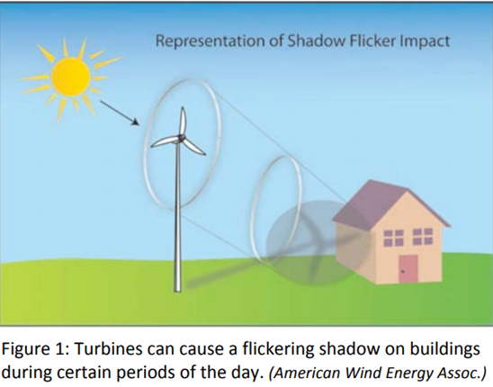
Shadow Flicker
Shadow flicker is an effect that can appear on neighboring properties due to the movement of wind turbine blades between the sun and the property.
Court Cases
Residents Opposed To Kittitas Turbines v. State Energy Facility Site Evaluation Council EFSEC (2008)
Time limits
30 hours per annum of flickering, in the worst case.
30 minutes maximum on the worst day of the year.
Real shadow impact is limited to 8 hours per year.

Slide 26
Aviation and Aircraft Safety
The Spokane International Airport and Fairchild AFB are invaluable economic resources to Spokane County.
Wind turbines can be a concern for Aviation and Aircraft Safety.
The applicant shall consult with the relevant authorities before installation in accordance with air traffic safety regulations.
To protect Aviation Radar, consultation shall be undertaken with the relevant aviation authorities to determine prevention and control measures.
The applicant shall avoid siting wind energy facilities close to airports and within known low-flying areas or flight paths.

Slide 27
Aviation and Aircraft Safety
Requires commercial wind farms to follow specific FAA guidelines when within a specified distance of a commercial airport.
Requires the applicant to consult and provide the USDOD with the conditional use permit.
Projects be required to provide evidence to the hearing examiner that the application will not affect military training operations or is no more incompatible than any other outright permitted uses in the applicable zoning district.
Source: Benton County Zoning Code

Slide 28
Decommissioning
Best Practices Recommendation (APA)
Recommends that counties create a decommissioning plan
Helps ensure that commercial wind farms are properly disposed of after their current use.
Ensures that the county is not responsible for decommissioning the commercial wind turbines
Bond or similar financial instrument
Based on the net cost of decommissioning
Required to disassemble and remove after a certain amount of days

Slide 29
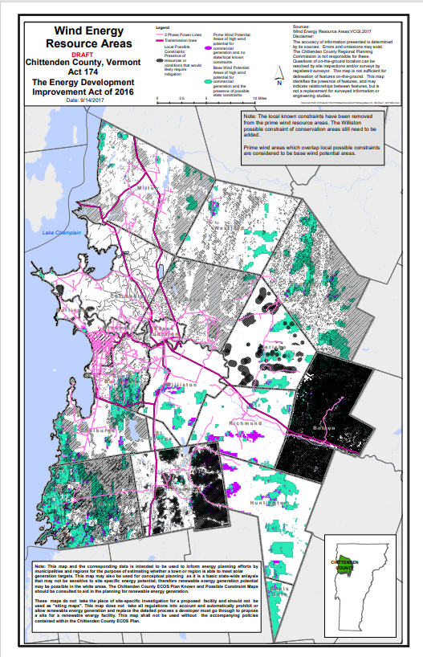
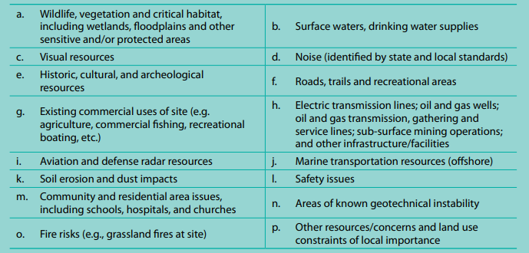
Constraint Map
“A site plan with sufficient detail to describe the nature and scope of the proposed project, the attributes of the specific location, as well as any potential issues or questions relating to the site chosen”.

